Slide 1
Lesson 02 Conditional Probability and Bayes’ Theorem Concepts E214 – Statistical Methods for Engineering

Slide 2
E214 – Statistical Methods for Engineering
Inferential Statistics
Hypothesis Testing
Parameter Estimation
Organise & summarise data collected
Probability and Distributions
Venn Diagram
Probability Distributions
Descriptive Statistics
Conditional Probability
Discrete Random Variables and Probability Distributions
Continuous Random Variables and Probability Distributions
Binomial Distribution
Poisson Distribution
Normal Distribution
Exponential Distribution
L02
A more detailed topic tree on Hypothesis Testing will be given from L08 onwards

Slide 3
Overview of Concepts
S/N | Concepts | Slide Number
1 | Independent and Dependent Events | 4-6
2 | Conditional Probability | 7-9
3 | Bayes’ Theorem | 10-11
4 | Using probability tree diagram to determine conditional probabilities | 12-14

Slide 4
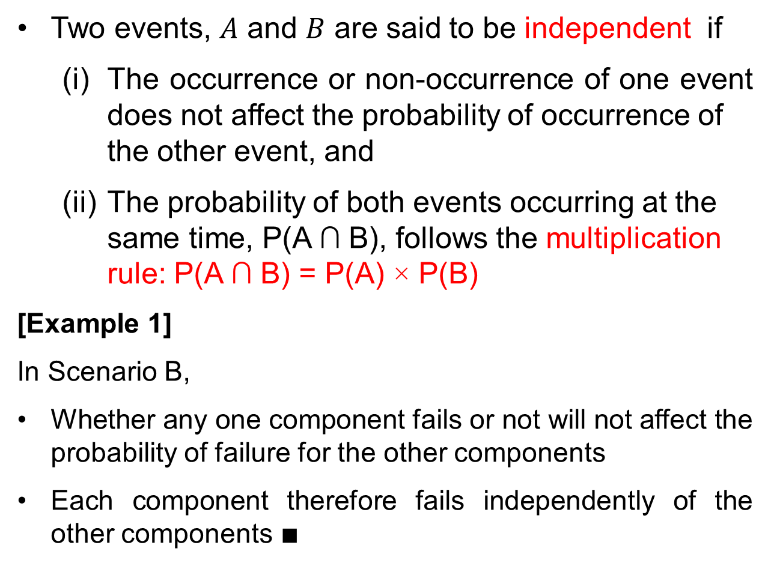
L01 Recap: Independent Events
Two events, $A$ and $B$ are said to be independent if
(i) The occurrence or non-occurrence of one event does not affect the probability of occurrence of the other event, and
(ii) The probability of both events occurring at the same time, P(A ∩ B), follows the multiplication rule: P(A ∩ B) = P(A) × P(B)
[Example 1]
In Scenario B,
Whether any one component fails or not will not affect the probability of failure for the other components
Each component therefore fails independently of the other components $∎$

Slide 5
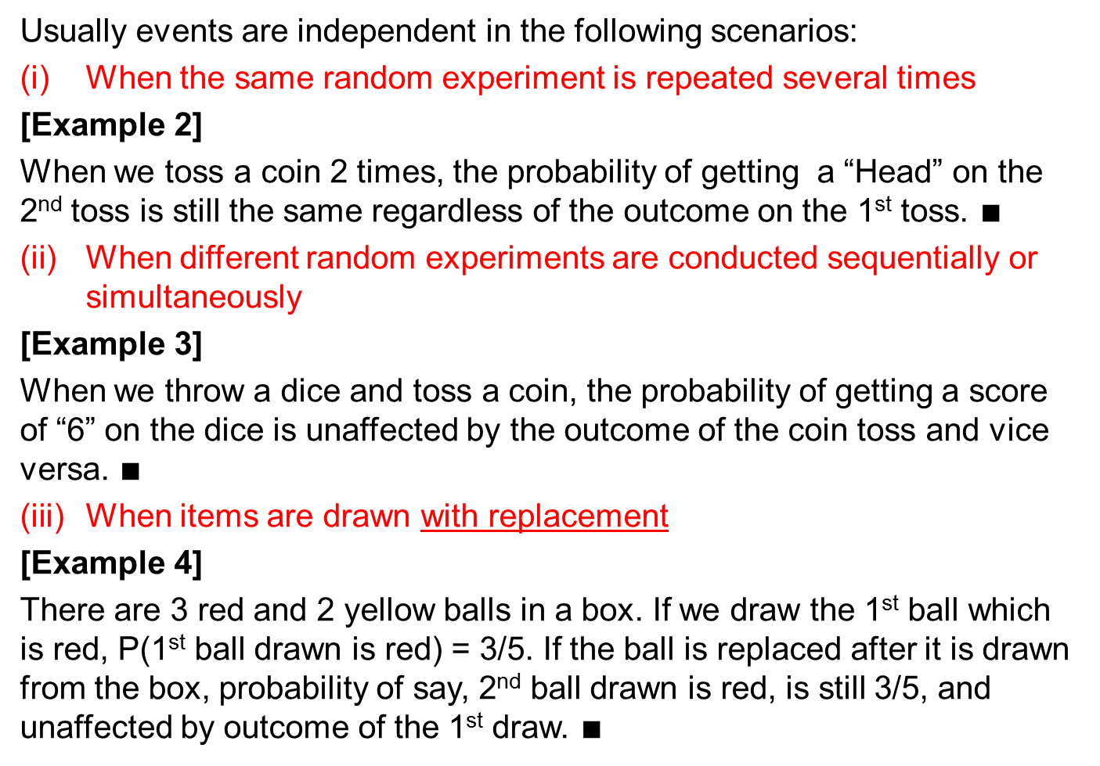
Independent Events
Usually events are independent in the following scenarios:
When the same random experiment is repeated several times
[Example 2]
When we toss a coin 2 times, the probability of getting a “Head” on the 2nd toss is still the same regardless of the outcome on the 1st toss. $∎$
When different random experiments are conducted sequentially or simultaneously
[Example 3]
When we throw a dice and toss a coin, the probability of getting a score of “6” on the dice is unaffected by the outcome of the coin toss and vice versa. $∎$
When items are drawn with replacement
[Example 4]
There are 3 red and 2 yellow balls in a box. If we draw the 1st ball which is red, P(1st ball drawn is red) = 3/5. If the ball is replaced after it is drawn from the box, probability of say, 2nd ball drawn is red, is still 3/5, and unaffected by outcome of the 1st draw. $∎$

Slide 6
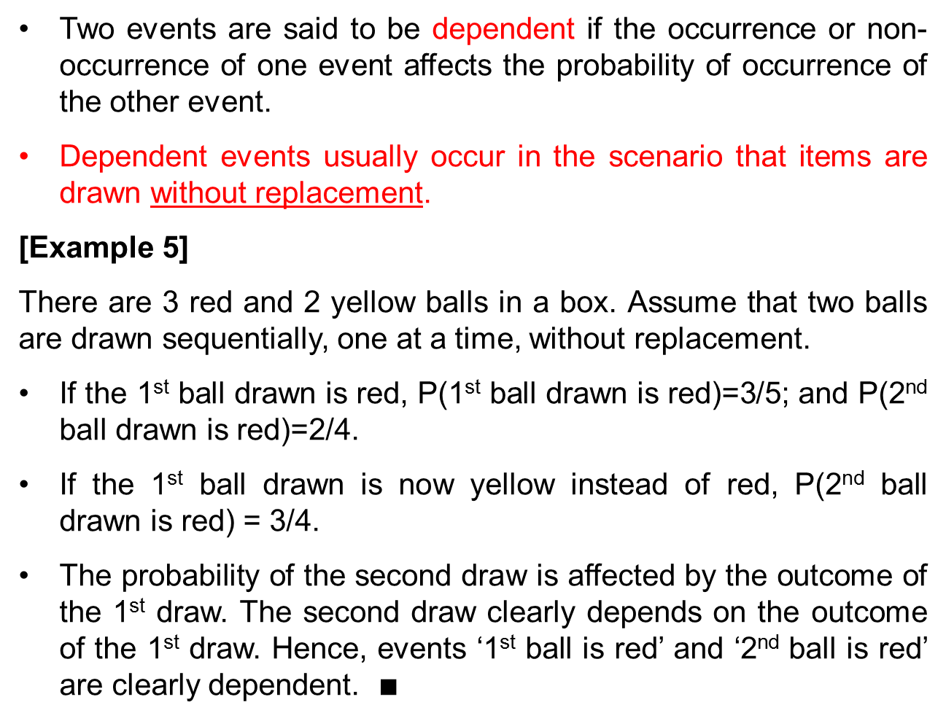
Dependent Events
Two events are said to be dependent if the occurrence or non-occurrence of one event affects the probability of occurrence of the other event.
Dependent events usually occur in the scenario that items are drawn without replacement.
[Example 5]
There are 3 red and 2 yellow balls in a box. Assume that two balls are drawn sequentially, one at a time, without replacement.
If the 1st ball drawn is red, P(1st ball drawn is red)=3/5; and P(2nd ball drawn is red)=2/4.
If the 1st ball drawn is now yellow instead of red, P(2nd ball drawn is red) = 3/4.
The probability of the second draw is affected by the outcome of the 1st draw. The second draw clearly depends on the outcome of the 1st draw. Hence, events ‘1st ball is red’ and ‘2nd ball is red’ are clearly dependent. $∎$

Slide 7
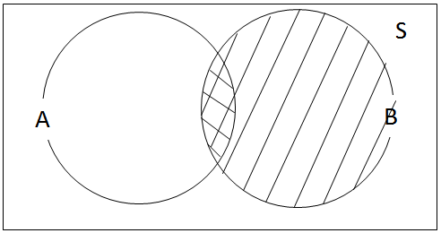

Conditional Probability
Very often, we are interested in the probability of an event happening given that another event has already happened. This is conditional probability.
If A and B are two events, then the conditional probability of A happening given that B has already occurred is denoted by P(A|B), where
In general, P(A|B) ≠ P(B|A)
0 ≤ P(A|B) ≤ 1 for all events A and B in sample space S.
P(S|B) = P(B|B) = 1
P(A|B) = P(B|A) = 0 if A and B are mutually
exclusive.
P(A'|B) = 1 – P(A|B)
To calculate $P\left(A | B\right),$ basically we take $P(A∩B)$divided by the probability of the reduced sample space, $B.$ Note that $B$ is the event that has already happened.

Slide 8
[Example 6]
Two distinct fair dice are rolled. What is the probability that the total sum is more than 10 given that the first die shows a “6”?
[Solution]
First, let us draw the sample space using the sample space table.
 | Score on first die
Score on second die |  | 1 | 2 | 3 | 4 | 5 | 6
 | 1 | 2 | 3 | 4 | 5 | 6 | 7
 | 2 | 3 | 4 | 5 | 6 | 7 | 8
 | 3 | 4 | 5 | 6 | 7 | 8 | 9
 | 4 | 5 | 6 | 7 | 8 | 9 | 10
 | 5 | 6 | 7 | 8 | 9 | 10 | 11
 | 6 | 7 | 8 | 9 | 10 | 11 | 12
Each outcome refers to the total sum of the scores on the two dice

Slide 9
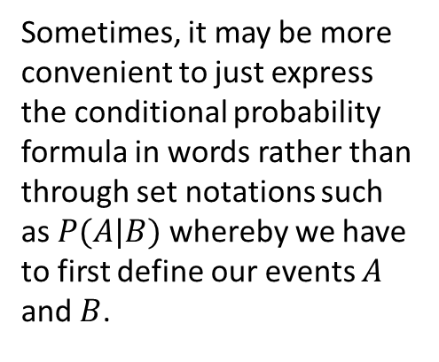
[Example 6]
This is a conditional probability question because of the key word, “given that”. So we apply the conditional probability formula.
P(total sum > 10 | first dice shows “6”)
Sometimes, it may be more convenient to just express the conditional probability formula in words rather than through set notations such as $P(A|B)$ whereby we have to first define our events $A$ and $B$.

Slide 10
Bayes’ Theorem and Conditional Probability
Bayes’ Theorem:
Derivation: Based on conditional probability, we have
The power of Bayes' Theorem is that in many situations where we want to compute P(A|B), it turns out that it is difficult to do so directly, yet we might have direct information about P(B|A). Bayes' Theorem enables us to compute P(A|B) in terms of P(B|A).
Note that in general, P(A|B) ≠ P(B|A).
P(A|B) = P(A∩B)/P(B) …….. (1)
P(B|A) = P(B∩A)/P(A) …….. (2)
Since P(A∩B) = P(B∩A), from equating (1) and (2),
P(A|B) × P(B) = P(B|A) × P(A) = P(A∩B)

Slide 11
[Example 7]
Box X contains 3 red sensors and 2 blue sensors, and Box Y contains 1 red sensor and 4 blue sensors. You randomly selected a sensor from one of the two boxes. What is the probability that a selected sensor is from Box X given that it is red?
[Solution]
Let A be the event “the selected sensor is from Box X”.
Let B be the event “the selected sensor is red”.
We are to find P(A|B).
Given
We require P(A|B). Using Bayes’ Theorem,

Slide 12
Probability Tree Diagram and Conditional Probability
A probability tree diagram can be used to show all of the possible outcomes or combinations of events. Besides Bayes’ Theorem, we can also use the tree diagram to determine conditional probabilities.
The probability of the final outcome is given by the sum of the products of the probabilities corresponding to each branch of the tree.
The probability tree diagram can be used for both dependent and independent events
[Example 8] Use the probability tree diagram to solve Example 7.
Select the sensor
Write down each outcome
Calculate the probability for each outcome
Select the box first
0.6
R
FR
0.5×0.6 = 0.3
0.5
F
0.4
B
FB
0.5×0.4 = 0.2
0.2
R
SR
0.5×0.2 = 0.1
0.5
S
All probabilities must add up to 1
0.8
B
SB
0.5×0.8 = 0.4
F: First Box
S: Second Box
R: Red Sensor
B: Blue Sensor
All probabilities must add up to 1

Slide 13
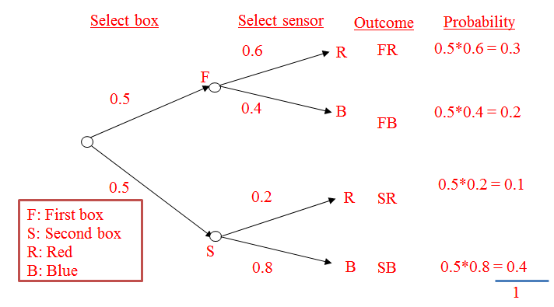
[Example 8]
Conditional Probability: the selected sensor is
Red given that it is from First Box: P(R | F ) = 0.6
Probability of the outcome FR, i.e., P(Red sensor drawn ∩ Sensor from Box 1) = 0.3
0.5 × 0.6 = 0.3
P(F∩R) = 0.3
P(R) = P(FR) + P(SR)
= 0.3 + 0.1
= 0.4
P(F|R) = P(F∩R)/P(R)
= 0.3/0.4
= 0.75
0.5 × 0.4 = 0.2
0.5 × 0.2 = 0.1
0.5 × 0.8 = 0.4

Slide 14
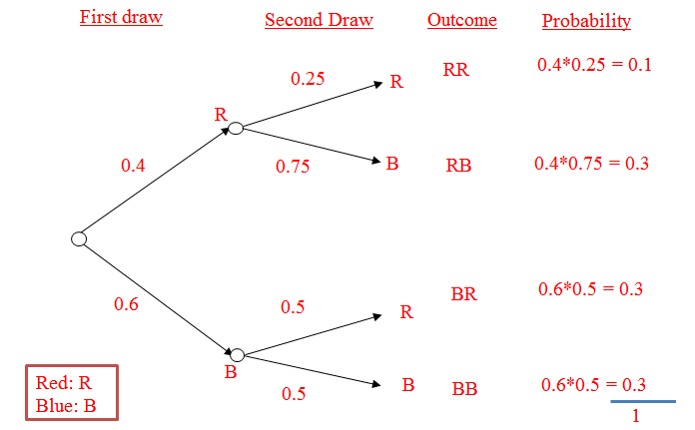
[Example 9]
There are 2 red sensors and 3 blue sensors in a bag. If two sensors are drawn one at a time randomly without replacement, find the probability of drawing one red and one blue sensor, in any order.
[Solution]
Conditional Probability:
P(Second draw red | First draw red) = 1/4
Probability of the outcome RR, i.e., P(first draw red ∩ second draw red ) = 0.1
0.4 × 0.25 = 0.1
0.4 × 0.75 = 0.3
P(Drawing 1R and 1B)
= P(RB) + P(BR)
= (0.4)(0.75) + (0.6)(0.5)
= 0.3 + 0.3
= 0.6
0.6 × 0.5 = 0.3
0.6 × 0.5 = 0.3

Slide 15
Learning Objectives
Explain the difference between independent and dependent events
Apply the concept of conditional probability
Apply and interpret the probability tree diagram to calculate probabilities for sequential events
Apply Bayes’ theorem to calculate conditional probability

Slide 16
E-Learning Video
You are strongly encouraged to watch the e-learning video prepared for L02 to enhance your understanding of the main learning objectives.
You can access the e-learning video from the following link:
https://drive.google.com/file/d/0B0VVo-P5cYtqRkNubGItYUtDbWc/edit?usp=sharing

